Slide 1

Project Title: Seasonal Agriculture Performance Analysis
[ Student Name:- Rahul Anil Kamble
College Name:- Hislop College, Civil Lines, Nagpur ]
AICTE STU ID : -STU6a6b67834d87e1785423747

Slide 2

PROBLEM STATEMENT
(Agricultural activities are influenced by seasonal variations in environmental conditions, farming practices, resource availability and market conditions. As a result, agricultural performance may differ from one season to another. However, raw agricultural data does not clearly explain how agricultural performance changes across seasons or what patterns can be observed in different seasonal conditions. The problem is to analyze the given agricultural dataset and investigate seasonal differences in agricultural performance by identifying meaningful patterns, trends, relationships and variations within the available data. )

Slide 3
Project Descrption :-
This project analyzes a seasonal agriculture dataset to understand how farming performance varies across seasons, regions, and conditions. It covers data cleaning, exploratory analysis, and visualization to uncover seasonal trends in crop yield, resource usage, and economic outcomes.
Statistical techniques are used to compare performance across seasons and identify significant patterns or relationships. The analysis is documented in a Jupyter Notebook, using Python libraries like Pandas, Matplotlib, and Seaborn.
The project concludes with evidence-based insights and recommendations to support better seasonal agricultural planning.

Slide 4

WHO ARE THE END USERS?
Farmers – To plan crops and resources based on seasonal trends
Agricultural policymakers/government bodies – To design season-specific support schemes and policies
Agribusiness companies – To plan supply chain, pricing, and resource distribution
Researchers/Agricultural scientists – To study seasonal impact on crop performance
Financial institutions/banks providing agri-loans – To assess seasonal risk before lending
NGOs working in rural development – To plan seasonal support programs for farmers

Slide 5

Technology Used
Google Colab – Cloud-based Jupyter Notebook environment used for writing and running the analysis
Python – Primary programming language used for data analysis
Pandas – For data cleaning and manipulation
NumPy – For numerical computations
Matplotlib / Seaborn – For data visualization (charts, graphs, plots)

Slide 6
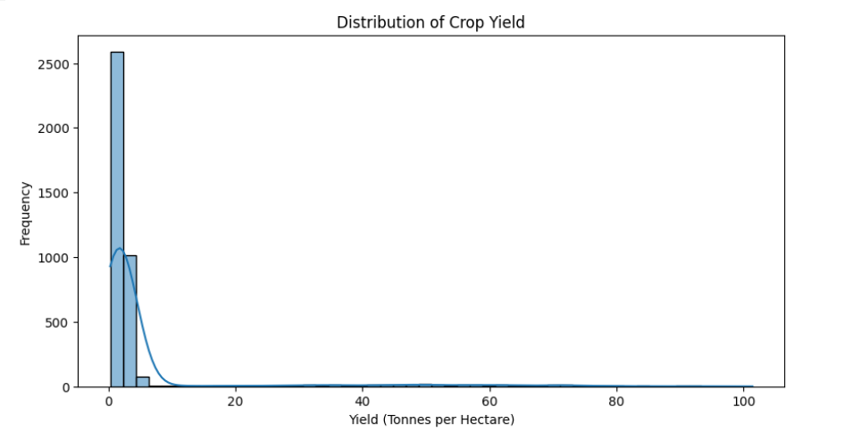
RESULTS
Distribution of Crop Yield

Slide 7
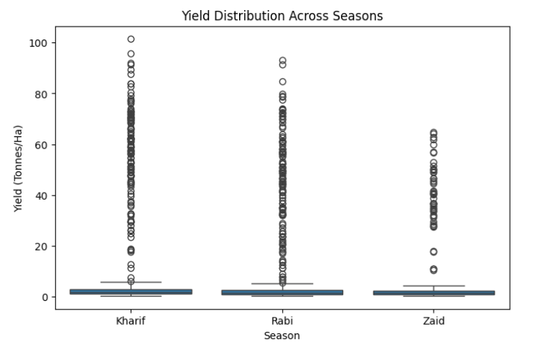
RESULTS
[Yield Distribution Across Seasons]

Slide 8
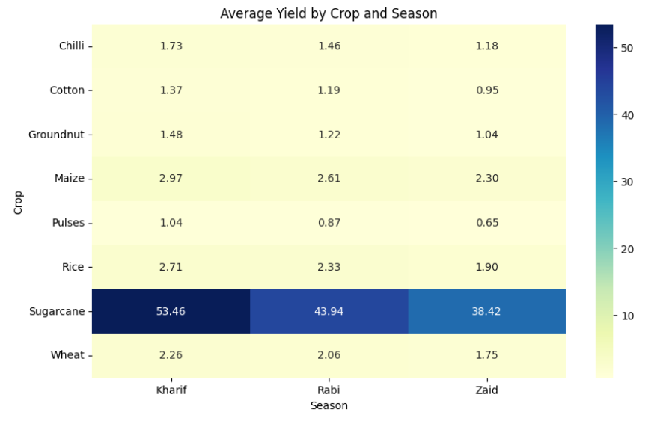
RESULTS
[Average Yield by Crop and Season ]

Slide 9
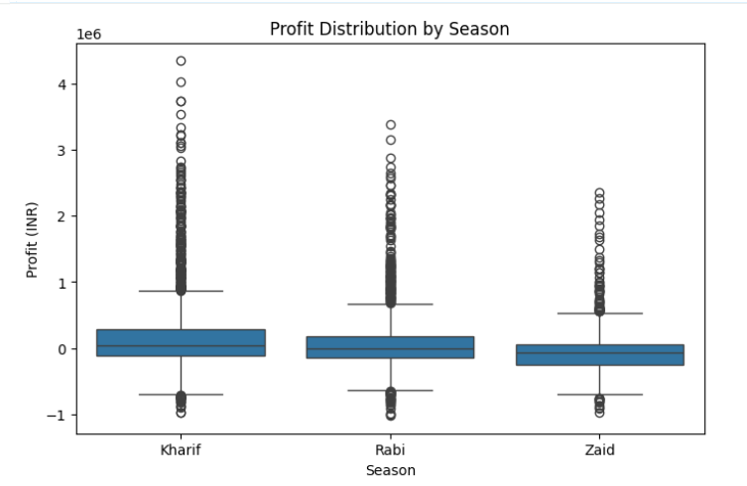
RESULTS
[Profit Distribution by Season ]

Slide 10
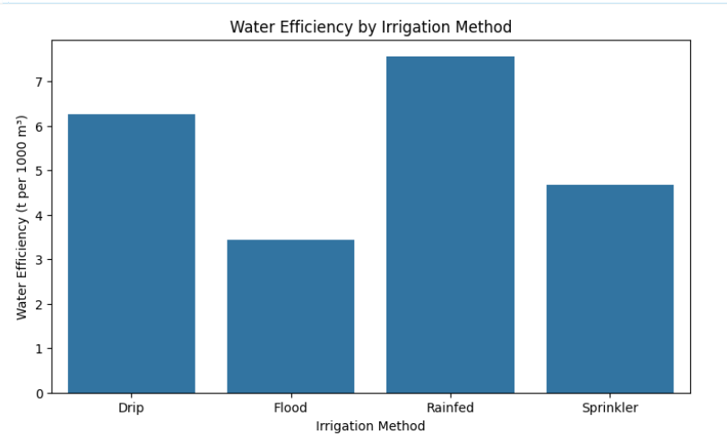
RESULTS
[Water efficiency by Irrigation Method]

Slide 11
Future scope: -
Predictive modeling – Use machine learning to forecast crop yield or performance for upcoming seasons
Real-time data integration – Connect with live weather/climate APIs for more accurate seasonal analysis
Larger and more diverse datasets – Include more regions, crops, and years for broader insights
Interactive dashboard – Build a dashboard (e.g., using Power BI/Tableau/Streamlit) for real-time visualization
Recommendation system – Suggest optimal crops or resource allocation based on predictions.

Slide 12
GitHub Link https://github.com/rahulK230506/Seasonal-Agriculture-Performance-Analysis.git
.

Slide 13

VOIS Course completion certificate -
Course name- Data Visualization

Slide 14
Thank you
Thank you for giving me the opportunity to present my project on Seasonal Agriculture Performance Analysis. Through this project, I got to explore real-world agricultural data and understand how seasonal factors impact farming performance. I'm thankful for the guidance and support throughout this project.
.
.

